Slide 1

Case study: catch-22
Cesar beltran
Perscholas

Slide 2

Overview
Case Study Premise
Catch22 is based on this concept that “a problem for which the only solution is denied by a circumstance inherent in the problem or by a rule.” Catch22 is a competition whereby participants must pay money (for borrowing equipment and fees) in order to make money (win the big prize!). The game at play here is bird watching in Brooklyn. There will be a specific list of 40 birds considered to be migratory species (meaning they do not live in Brooklyn all year long) as they travel northbound or southbound depending on the season. Each participant will be lent equipment such as DSLR cameras with zoom lenses (along optional binoculars) to go and chase these little beasts! The pictures will be verified by park organizers to validate the species reported by participant. Whoever captures a total of 22 birds from that exclusive list will earn big bucks! The goal is to enroll as many as 100 participants to get enough funds to donate to park conservation efforts to improve the natural of environment of these animals!
Participant will be able to:
- Enroll using a website provided by Cesar’s birding club: localhost:8080
- Submit payment for borrowing basic equipment needed to take amazing pictures of birds and have fun at it
- Keep track of the competition to see who has captured the most birds!
- Access park organizers’ information about facts about the park and when during the week there will be group walks in the park to watch birds
- See when the expected due date to return borrowed items is
- See participating parks
- See the list of birds at a glance
- Keep track of number of species captured!

Slide 3
Business application
The theoretical business application of this application to to automate the process of participating in a competition. The participant would access the registration process, borrowing capabilities of equipment needed for this competition, contact information for people organizing this event, and meeting times for groups walks. In addition, the participant will be able to compare their progress compared to their peers. There will be a common database that will contain information regarding borrowed equipment, payment information, and species list.
The goal is to run this competition each spring and fall (during the migratory bird season) to galvanize people to join. The funds or profit made will be used for wildlife conservation efforts in NYC.
By improving the efficiency of running a bird watching competition like this, money will be saved in hiring personnel to run it. Thus, all that money saved will be put into nature to make a better better parks for New Yorkers.

Slide 4
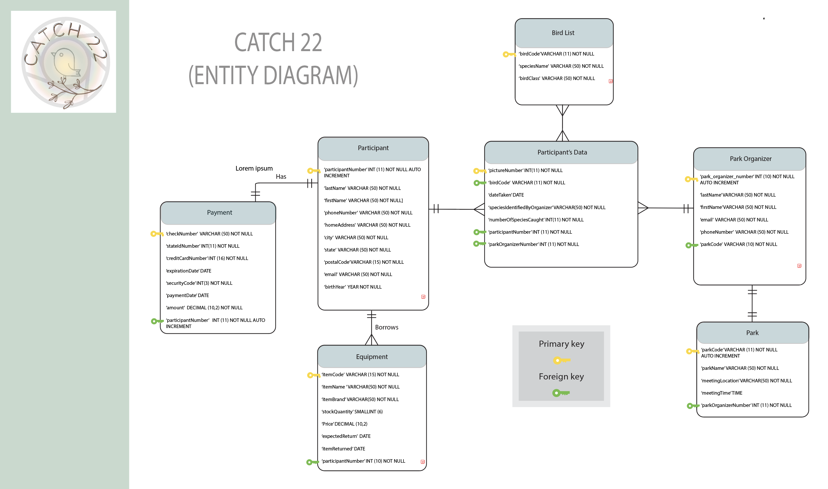

Slide 5
Lessons learned
Creation of SQL databases that serve as storage unit for users to input their data straight from a website
– This case study taught me the importance of time management. This field does not work with cramming. There has to be a well laid out plan to move ahead and succeed completing any project.
Java is a powerful computing language. While learning on my own some of the concepts taught, there are a lot of java users that come up with very interesting applications.
-Troubleshooting is part of java programming. There encountered many challenges in integrating concepts learned in this bootcamp.
-Attention to detail is a must in this field as a misplaced semi-colon can derail a whole project.

Slide 6
Additional features
More repositories were needed to allow user more access to this application
Security system is lacking in my project
To increase participant engagement bootstrap features is probably a good idea
Adding external reference for wildlife information
A shopping cart made sense for this project. Instead of having a BUY button, the participant can have a CATCH button to add a specific bird to their collection list!

Slide 7

FIN

